Slide 1
Python selection statements and loops

Slide 2
Python If ... Else
Python supports the usual logical conditions from mathematics:
Equals: a == b
Not Equals: a != b
Less than: a < b
Less than or equal to: a <= b
Greater than: a > b
Greater than or equal to: a >= b
E.g
a = 33 b = 200 if b > a: print("b is greater than a")

Slide 3
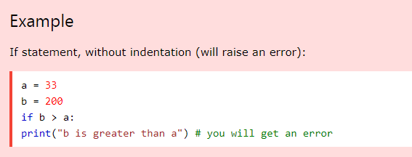
Indentation
Python relies on indentation (whitespace at the beginning of a line) to define scope in the code.
Other programming languages often use curly-brackets for this purpose.

Slide 4
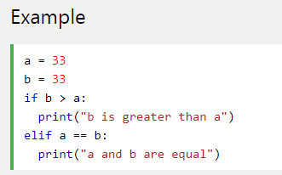
Elif
The elif keyword is pythons way of saying "if the previous conditions were not true, then try this condition".

Slide 5
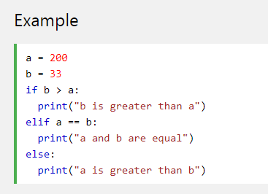
Else
The else keyword catches anything which isn't caught by the preceding conditions.

Slide 6
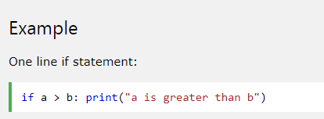
Short Hand If
If you have only one statement to execute, you can put it on the same line as the if statement.

Slide 7
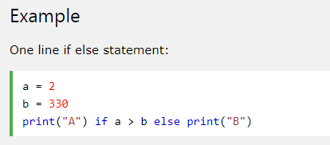
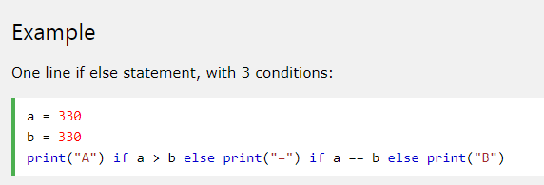
Short Hand If ... Else
If you have only one statement to execute, one for if, and one for else, you can put it all on the same line:
This technique is known as Ternary Operators, or Conditional Expressions.
You can also have multiple else statements on the same line:

Slide 8
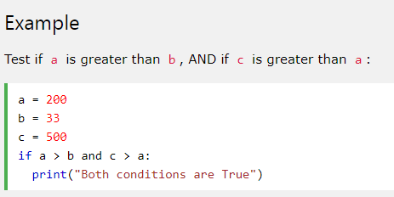
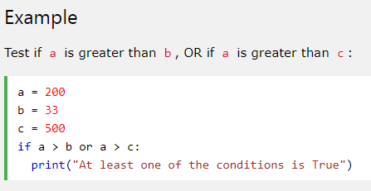
And, Or
The and, or keyword is a logical operator, and is used to combine conditional statements:

Slide 9
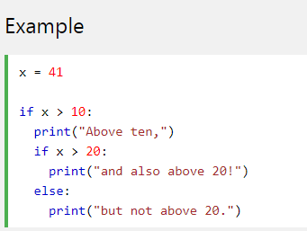
Nested If
You can have if statements inside if statements, this is called nested if statements.

Slide 10
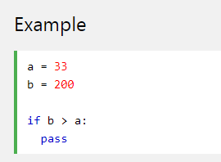
The pass Statement
if statements cannot be empty, but if you for some reason have an if statement with no content, put in the pass statement to avoid getting an error.

Slide 11
Python While Loops

Slide 12
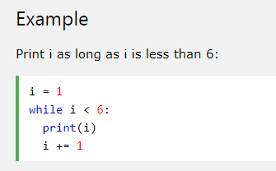
The while Loop
With the while loop we can execute a set of statements as long as a condition is true.
The while loop requires relevant variables to be ready, in this example we need to define an indexing variable, i, which we set to 1.

Slide 13
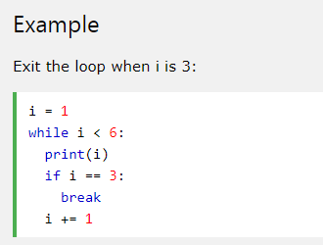
The break Statement
With the break statement we can stop the loop even if the while condition is true:

Slide 14
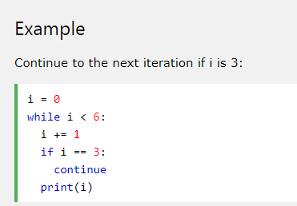
The continue Statement
With the continue statement we can stop the current iteration, and continue with the next:

Slide 15
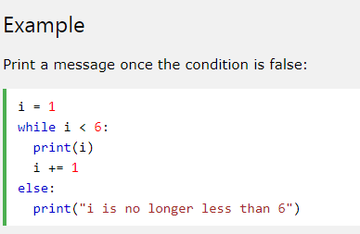
The else Statement
With the else statement we can run a block of code once when the condition no longer is true:

Slide 16
Python For Loops

Slide 17
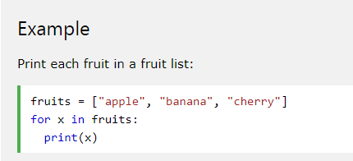
Python For Loops
A for loop is used for iterating over a sequence (that is either a list, a tuple, a dictionary, a set, or a string).
This is less like the for keyword in other programming languages, and works more like an iterator method as found in other object-orientated programming languages.
With the for loop we can execute a set of statements, once for each item in a list, tuple, set etc.
The for loop does not require an indexing variable to set beforehand.

Slide 18
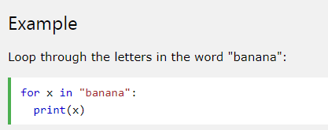
Looping Through a String
Even strings are iterable objects, they contain a sequence of characters:

Slide 19
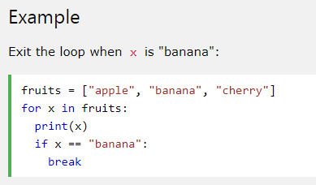
The break Statement
With the break statement we can stop the loop before it has looped through all the items:

Slide 20
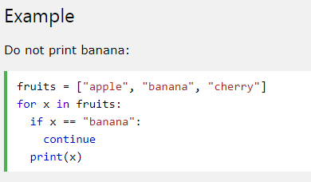
The continue Statement
With the continue statement we can stop the current iteration of the loop, and continue with the next:

Slide 21
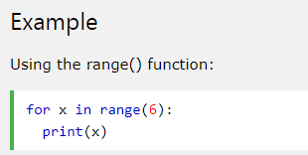
The range() Function
To loop through a set of code a specified number of times, we can use the range() function,
The range() function returns a sequence of numbers, starting from 0 by default, and increments by 1 (by default), and ends at a specified number.

Slide 22
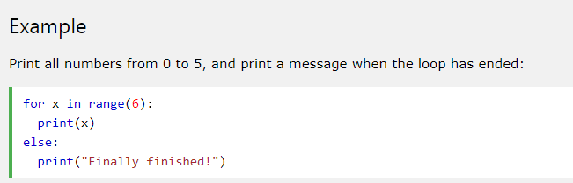
Else in For Loop
The else keyword in a for loop specifies a block of code to be executed when the loop is finished:

Slide 23
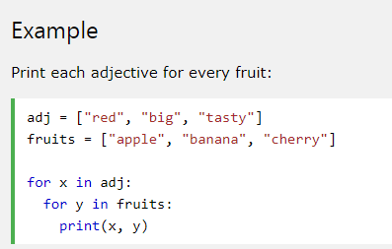
Nested Loops
A nested loop is a loop inside a loop.
The "inner loop" will be executed one time for each iteration of the "outer loop":

Slide 24
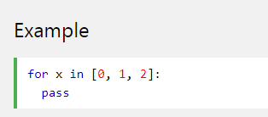
The pass Statement
for loops cannot be empty, but if you for some reason have a for loop with no content, put in the pass statement to avoid getting an error.

